Slide 1
Lecture 8: (Abbreviated) Lasso Regression & Catch-up

Slide 2
“Sparsity”
Vector w is sparse if many entries are zero
  For example, if you roll a single die 3 times and record how many 1’s, 2’s, 3’s, 4’s, 5’s, and 6’s, you will have a sparse vector
  In reality entries close to zero are sometimes considered “sparse”
    Two definitions depending on context!!
Useful in many tasks
  Efficiency: if size(w) is a billion, each prediction is expensive:
    If part of an online system, this can be very slow
    If w is sparse, prediction computation only depends on number of non-zeros

Slide 3
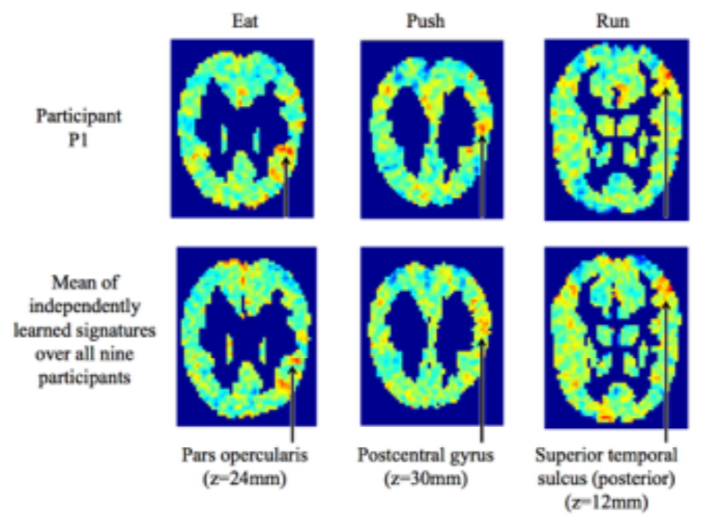
“Sparsity”
Useful in many tasks
  Efficiency: if size(w) is a billion, each prediction is expensive:
    If part of an online system, this can be very slow
    If w is sparse, prediction computation only depends on number of non-zeros
  Interpretability: what are the relevant dimensions to make a prediction?
    What are the parts of the brain associated with particular words?

Slide 4
Question: How do we find the “best” subset among all possible features?

Slide 5
Greedy model selection
Pick features
Greedy heuristic:
  Start from an empty (or simple) set of features, F₀ = null
  Run learning algorithm for current set of features, F_{t}
    Obtain weights for these features
  Select next best feature, h_{i}(x)*
    That is, h_{j}(x) that results in the lowest training error when using F_{t} + {h_{j}(x)*}
  F_{t+1} <- F_{t} + {h_{i}(x)*}
  Recurse

Slide 6
Greedy model selection
Applicable in many situations (some of which we’ll talk about later in this course):
  Logistic regression: selecting features (basis functions)
  Naïve Bayes: selecting (independent) features p(X_{i}|Y)
  Decision trees: selecting leaves to expand
Only a heuristic
  Finding the best set of k features is computationally intractable!

Slide 7
Greedy model selection
Recurse until??? When do you stop?
  When training error is low enough?
  When test set error is low enough?
  Using cross validation?
  Is there a set solution that makes sense?

Slide 8
Lasso regression
Least Absolute Shrinkage and Selection Operator
Finds the coefficients that should be used (like linear regression)
Also provides best subset selection, which indicates the most valuable variables for using for machine learning

